Slide 1

A STUDY OF PERFORMANCE OF DIFFERENT ALGORITHMS ON GYMNASIUM ENVIRONMENT
RAUNAK MORE
KAREEM ABDUL

Slide 2
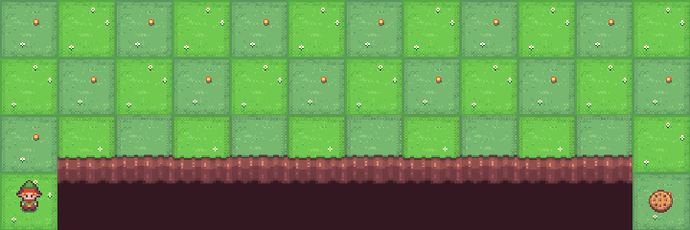
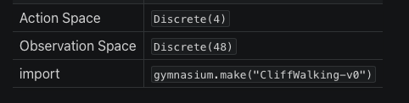
Cliff Walking-v0
This environment is part of the Toy Text environment which contains general information about the environment.
Cliff walking involves crossing a grid world from start to goal while avoiding falling off a cliff.
The game starts with the player at location [3, 0] of the 4x12 grid world with the goal located at [3, 11]. If the player reaches the goal the episode ends.
A cliff runs along [3, 1..10]. If the player moves to a cliff location it returns to the start location. The player makes moves until they reach the goal.

Slide 3
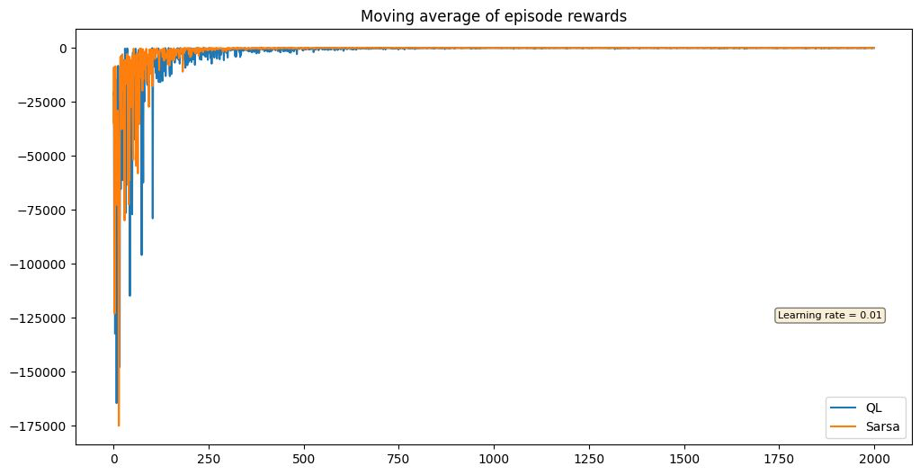
Observations
Running algorithms for 2000 episodes and plotting reward vs episode
This Image showed the reward vs Episodes run
Since it was difficult to gain info on the convergence, we used Moving Average to find trends in the rewards acquired

Slide 4
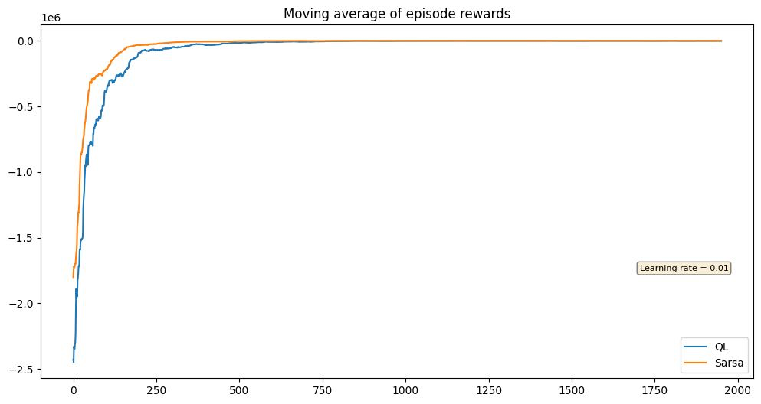
Observations
The Moving average was taken for 250 episodes.
For this particular environment ,we saw SARSA converged faster than Q Learning

Slide 5
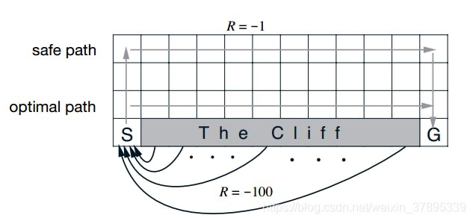
Observations
It was also observed that Path taken by Q learning was more aggressive/Unsafe than that taken by Sarsa
Optimal Path was taken by Q learning
Middle Path was taken by Sarsa

Slide 6
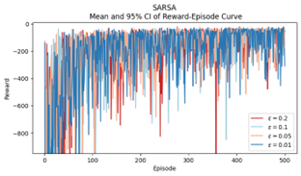
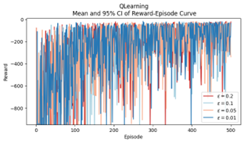
Observations
For both Algorithms, a faster rate of convergence was seen with lower values of Epsilon
The instability of rewards attained was much more in Q Learning compared to Sarsa

Slide 7
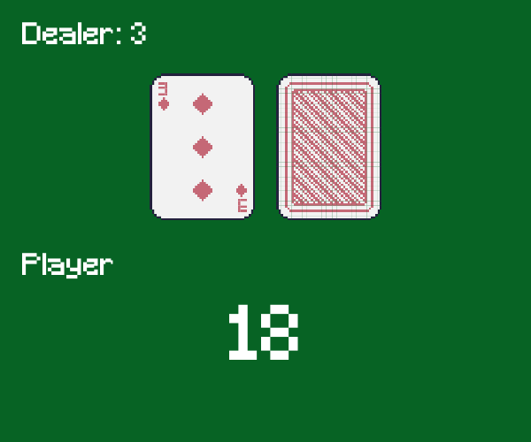
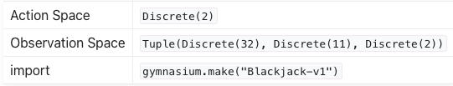
Blackjack-v1
Blackjack is a card game where the goal is to beat the dealer by obtaining cards that sum to closer to 21 (without going over 21) than the dealer’s cards.
The card values are:
Face cards (Jack, Queen, King) have a point value of 10.
Aces can either count as 11 (called a ‘usable ace’) or 1.
Numerical cards (2-9) have a value equal to their number.

Slide 8
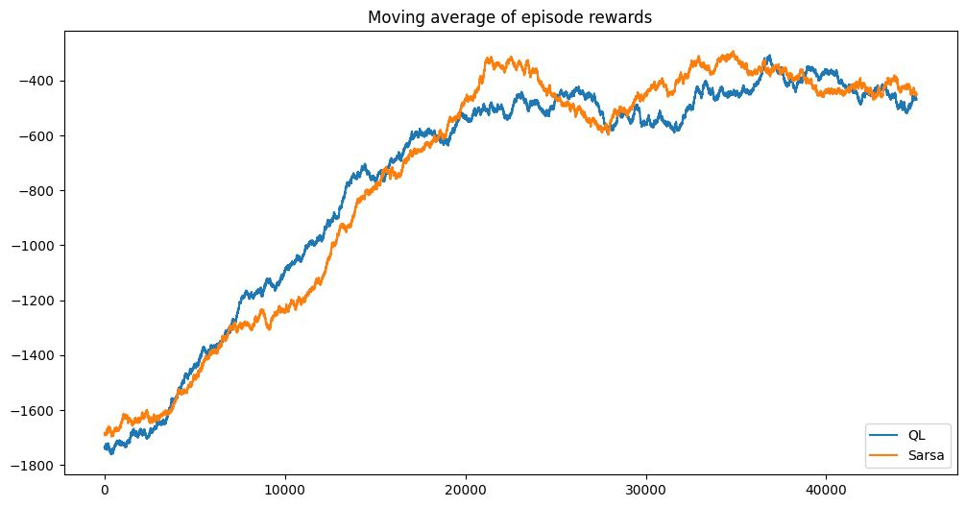
We also ran the algorithms on Black Jack-v1 Environment for 50000 Episodes each with
It was seen that SARSA converged faster but had more unstable than Q Learning
As the environment of Blackjack itself is random rewards remained in negative throughout and the plots changed a lot too with no concrete pattern on higher episodes.

Slide 9
Future Additions
Optimization of both Epsilon and Learning Rate
Using fixed Learning Rates or one dependent on the number of samples.

Slide 10
Thank You.

